Slide 1

U.S. Airline Performance & Delay Analysis
Prepared By: UMESH
Date: 31 JULY 2020

Slide 2

Problem Statement
Flight delays and cancellations impact passengers, airlines, and the economy.
Identify key drivers, assess performance, and propose improvements.

Slide 3
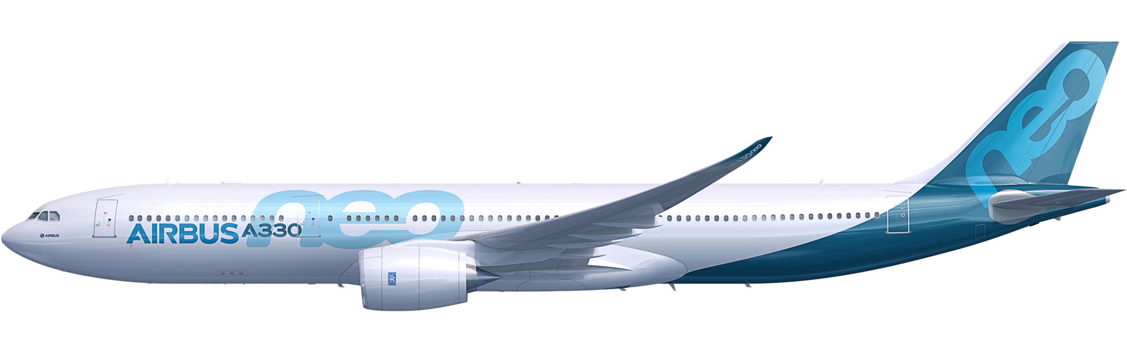
Objectives
• Identify primary causes of delays & cancellations.
• Benchmark airline & airport performance.
• Analyze seasonal, daily, and route patterns.
• Provide actionable recommendations.

Slide 4

Methodology
• Data Sources:
Flights, Airlines, Airports datasets (2015)
• Tools:
SQLite (Data Cleaning, EDA) + Power BI (Visualization)
• Approach:
Data integration, dashboard creation, analysis.

Slide 5
SQL Implementation
• Data Cleaning:
- Handled null values in delay and time fields.
- Converted HHMM time fields to HH:MM format.
- Created descriptive cancellation reason column.
• EDA:
- Analyzed delays by airline, month, and day of week.
- Identified top delay-prone routes.
- Investigated delay distributions (weather, airline, ATC, security).
• Integration:
- Joined flights with airlines and airports datasets.
- Ensured data consistency and validation.

Slide 6
Power BI Dashboard Overview
• Page 1: Overview (KPIs, delay map)
• Page 2: Airline Performance (Comparisons, reasons)
• Page 3: Airport & Routes (Heatmaps, busiest airports)
• Page 4: Delay Reasons & Forecasting (Predictions)

Slide 7
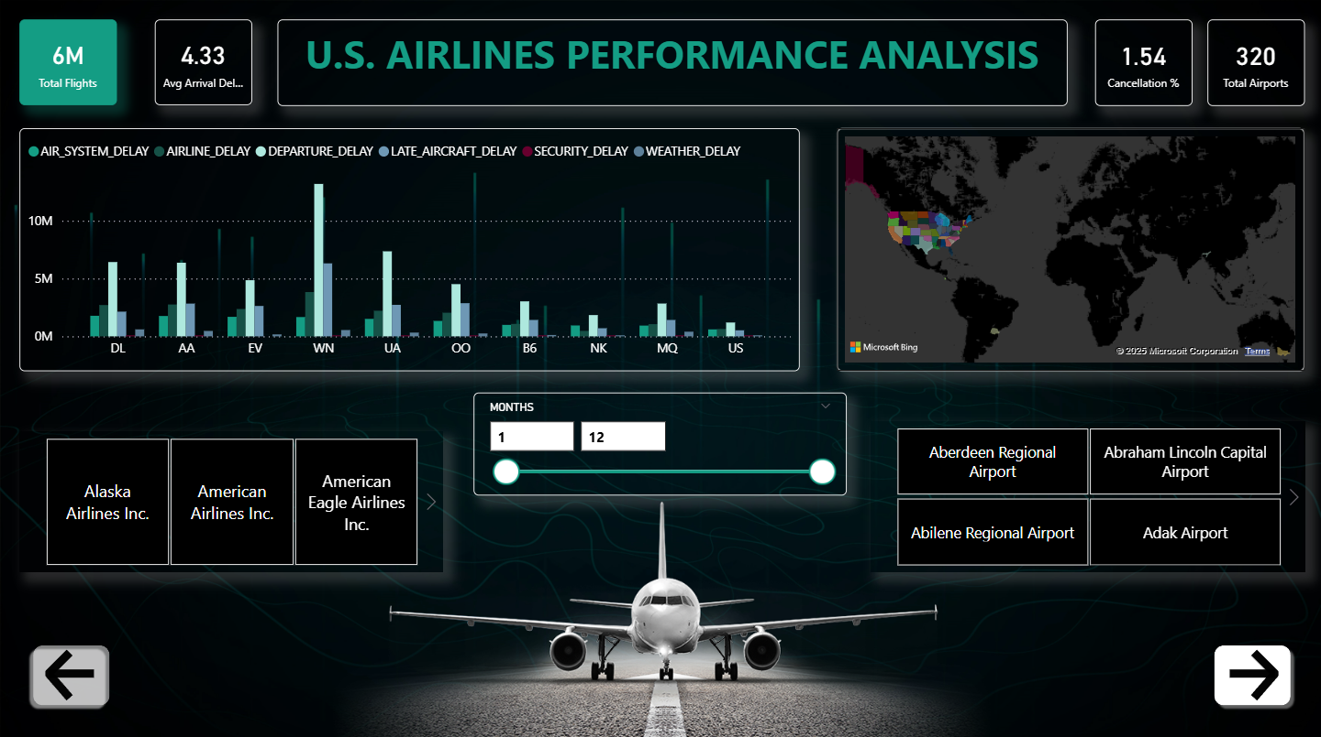
Page 1: Overview (KPIs, delay map)

Slide 8
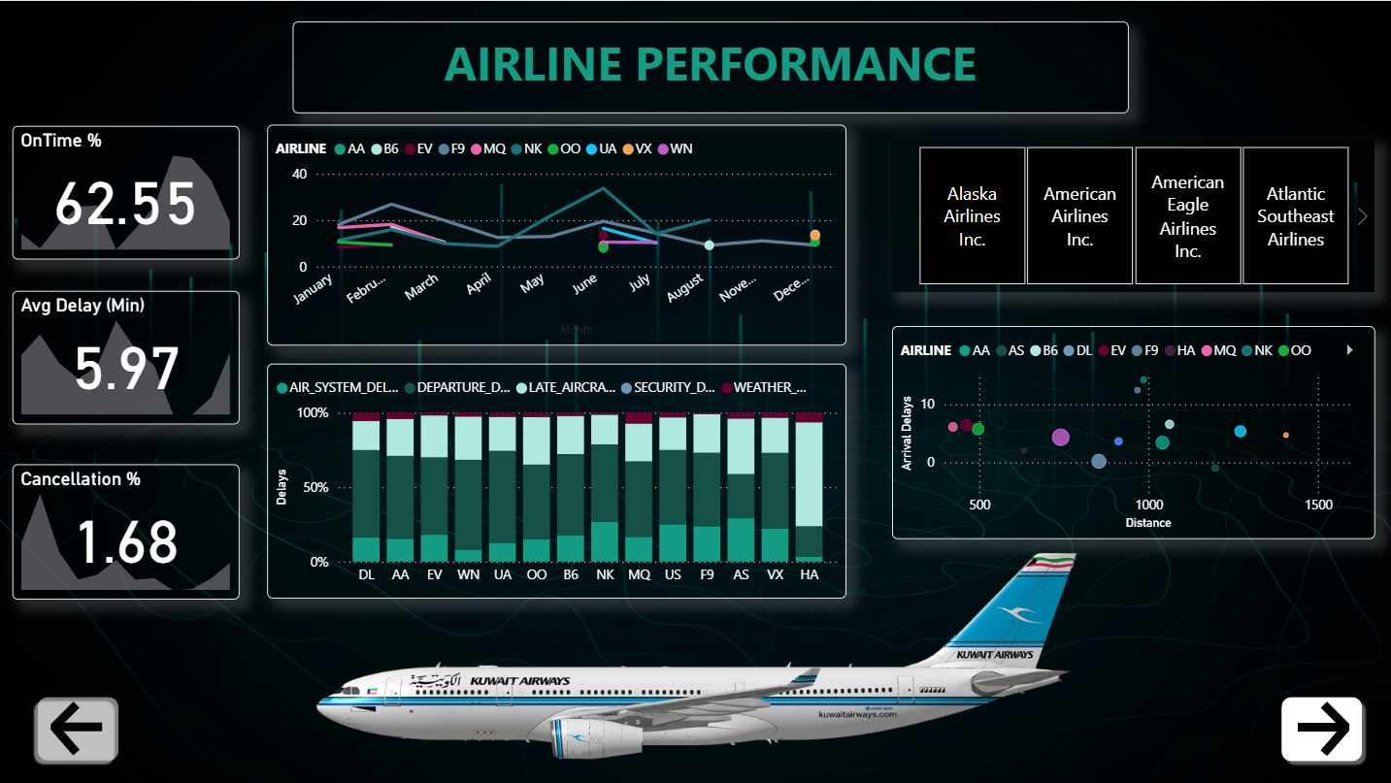
Page 2: Airline Performance (Comparisons, reasons)

Slide 9
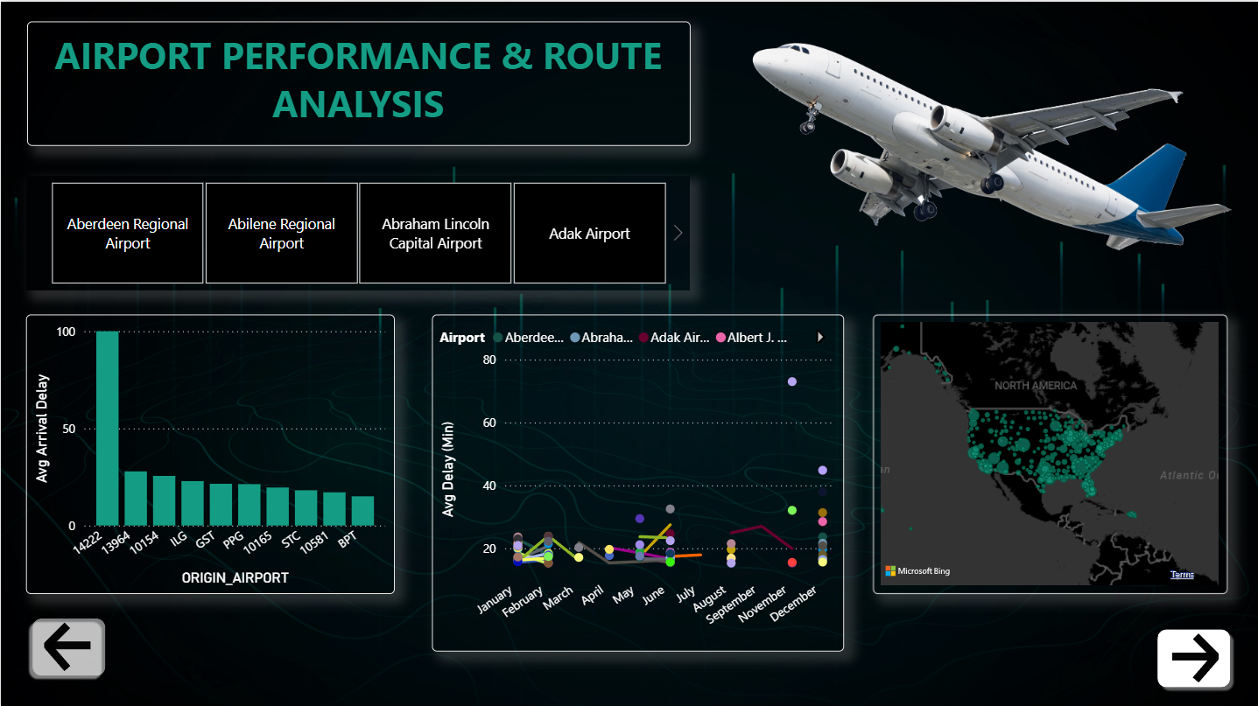
Page 3: Airport & Routes (Heatmaps, busiest airports)

Slide 10
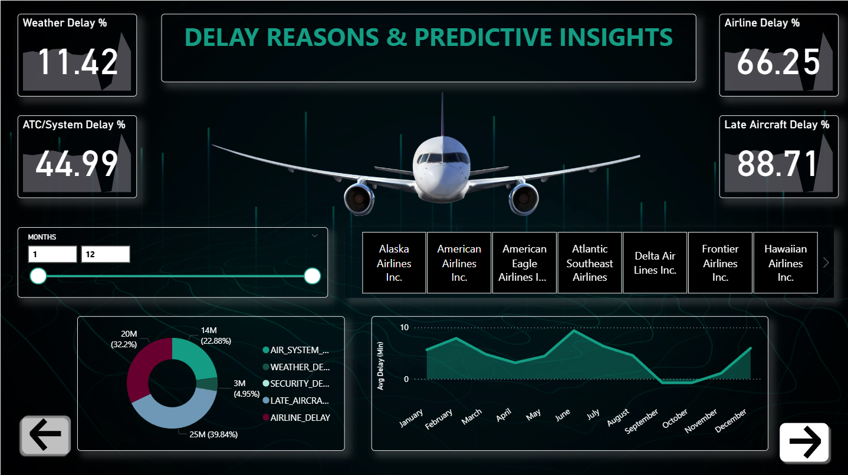
Page 4: Delay Reasons & Forecasting (Predictions)

Slide 11

Key Findings – Overall
• ~6M flights analyzed.
• OTP: ~78% | Cancellations: ~2%.
• Delays peak in summer & holidays.

Slide 12
Key Findings – Airlines & Airports
• Certain airlines have higher weather & late aircraft delays.
• Some maintain high OTP despite heavy schedules.
• Congested airports show high taxi-out & arrival delays.
• Some major airports perform well despite volume.

Slide 13
Recommendations
• Focus improvements at delay-prone airports.
• Adjust scheduling in peak delay months/days.
• Reduce turnaround & taxi delays.
• Implement weather mitigation plans.

Slide 14

Conclusion & Limitations
• Actionable insights for airlines & regulators.
• Limitation: Dataset covers only 2015.
• Recommendation: Multi-year analysis for better trends.

Slide 15

THANK YOU!

